Slide 1




Slide 2

DIVISION OF WAGES

Slide 3
DIVISION OF WAGES
Division of wages is an extension of Time and Work chapter.
In this chapter we convert work performed in monetary terms.
Wages are given in proportion to the work done and in indirect (or inverse) proportion to the time taken by the individual.
You can find the ratios by comparing the efficiency of the worker.

Slide 4
Question: 01
Ravi can do a work in 6 days and Rahim can do the same work in 5 days.The contract for the work is Rs. 220. How much shall B get if both of them work together?
140
120
180
80
Notes:
B

Slide 5
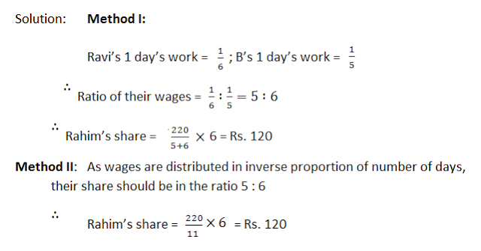
Explanation: 01

Slide 6
Question: 02
A, B and C can do a work in 6, 8 and 12 days respectively. Doing that work together they get an amount of Rs 1350. What is the share of B in that amount?
250
350
450
550
Notes:
C

Slide 7
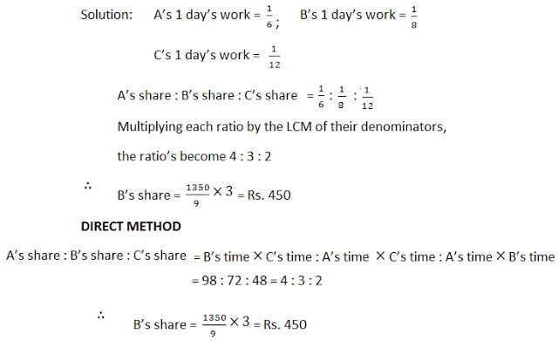
Explanation: 02

Slide 8
Question: 01
Question: 03
A, B and C contract a work for Rs. 550. Together, A and B are supposed to do 7/11 of the work. How much does C get ?
235
100
320
200
Notes:
D

Slide 9
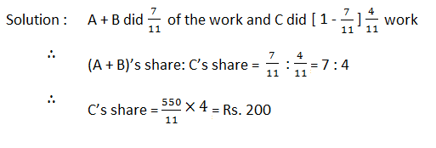
Explanation:
Explanation: 03

Slide 10
Question: 04
Two men undertake to do a piece of work for Rs. 200. One alone could do it in 6 days, the other in 8 days. With the assistance of a boy they finish it in 3 days. How should the money be divided?
100
75
50
25
Notes:
D

Slide 11
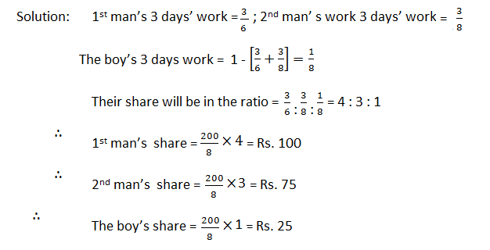
Explanation: 04

Slide 12
Question: 05
A and B undertook to do a piece of work for RS 4500. A alone could do the work in the 8 days and B in 12 Days. With the assistance of C, they finished the work in 4 days. What is the share of C?
750
1500
900
2250
Notes:
A

Slide 13
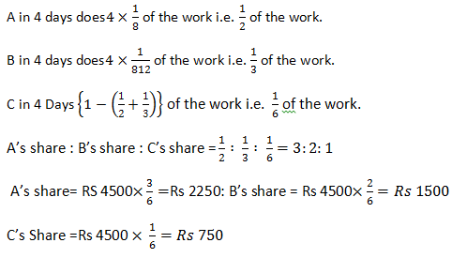
Explanation: 05

Slide 14
Question: 06
12 Men and 6 women can do a piece of work in 14 days, while 8 men and 9 women can do the work in 16 days. if a man gets Rs 54 per days, what should be the wage of a woman per day?
72
36
68
98
Notes:
B

Slide 15

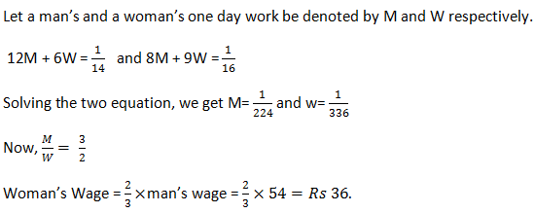
Explanation: 06

Slide 16
Question: 07
If the wage of 45 women amount to Rs 15525 in 48 days, how many men must work for 16 days to receive Rs 5750, The daily wage of a man being double of that of a woman?
115
115/8
145/8
212
Notes:
B

Slide 17
Explanation: 07
women= 45
days = 48
amount for men = Rs.15525
efficiency= 1
days used by men=16
amount for men = Rs.5750
efficiency=2
M1 D1 E1 / W1 = M2 D2 E2 / W2
(45*48*1)/ 15525 = (M*16*2)/5750
M=(2160*5750)/(15525 * 32)
M = 25

Slide 18
Question: 08
A can do a piece of work in 10 days while B alone can do it in 15 days. They work together for 5 days and the rest of the work is done by C in 2 days. If they get Rs 450 for the whole work, how should they divide the money?
(a) Rs 100. Rs 150, Rs 200
(b) Rs 80, Rs 170, Rs 200
(c) Rs 225, Rs 150, Rs 75
(d) Rs 200, Rs 50, Rs 200
Notes:
b

Slide 19
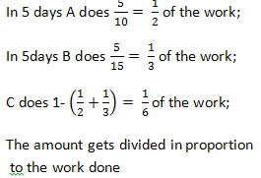
Explanation: 08

Slide 20
Question: 02
Question: 09
A sum of Rs 77 was paid for a piece of work which A can do in 10 days, B in 15 days, C in 20 days and D in 25 days. Find the share of C, if all of them worked together.
(a) Rs 12
(b) Rs 17
(c) Rs 15
(d) Rs 18
Notes:
c

Slide 21
Explanation:
Explanation: 09

Slide 22
Question: 10
Wages for 45 women amount to Rs 15525 in 48 days. How many men must work 16 days to receive Rs 5750, the daily wages of a man being double those of a woman?
25
35
45
20
Notes:
A

Slide 23
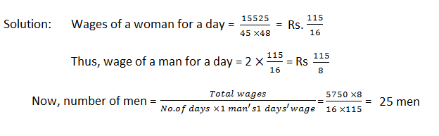
Explanation:
Explanation: 10

Slide 24
Question: 04
Question: 11
Starting on Monday morning Ram can finish a task by Friday evening while Shyam takes 2 days more to get over with the same task. They take up a project together and are paid Rs 480/- for it. How much should be Shyam's share in the earnings?
a. Rs. 180
b. Rs. 200
c. Rs. 280
d. Rs. 300
Notes:
b

Slide 25
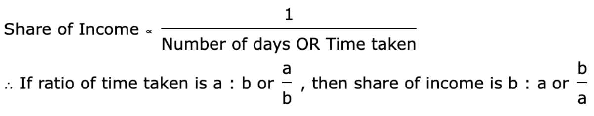
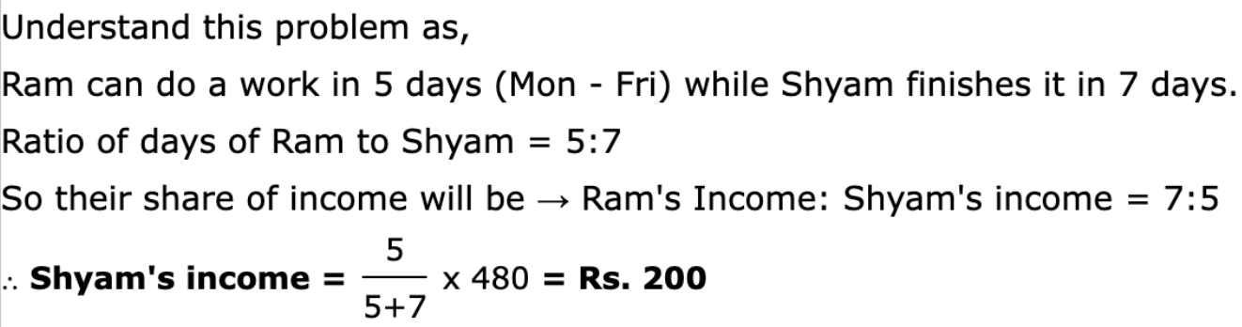
Explanation:
Explanation: 11

Slide 26
Question: 12
Working individually Piky, Quiky and Riky finish an assignment in 7, 8 and 11 days respectively. They work together on a project and are paid 1105 silver coins for it. Find the share of each of them in the earnings.
a. Piky = 440 coins; Quiky = 385 coins; Riky = 280 coins
b. Piky = 445 coins; Quiky = 375 coins; Riky = 285 coins
c. Piky = 446 coins; Quiky = 381 coins; Riky = 278 coins
d. Piky = 500 coins; Quiky = 400 coins; Riky = 205 coins
Notes:
a

Slide 27
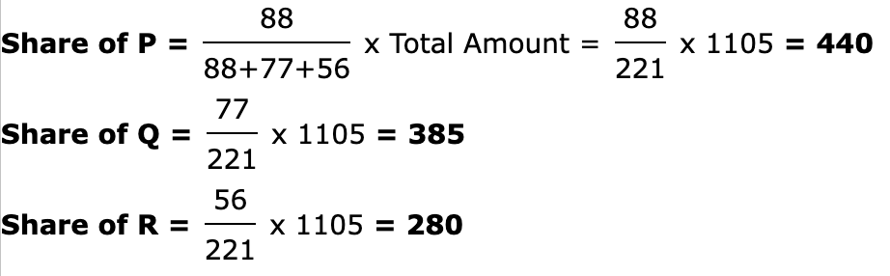
Explanation:
Explanation: 12
Let us consider Piky to be P, Quicky to be Q and Riky to be R.
Now, P takes 7 days; Q takes 8 days and R takes 11 days to complete the job
Ratio of days taken is P:Q:R = 7:8:11
If ratio of time taken is a : b : c, then share of income is in ratio
bc : ac : ca
Easy way to remember -
Share of 'a' will only have 'bc' and not 'a'
Share of 'b' will only have 'ac' and not 'b'
Share of 'c' will only have 'ab' and not 'c'
Hence, Ratio of income share is
Income of P : Income of Q : Income of R = 8 x 11 : 7 x 11 : 7 x 8 = 88 : 77 : 56

Slide 28
Question: 13
Daily wages of men are 500% those of women. Two groups of 22 women each earn Rs 29568 while working for 8 weeks. Some men work on a similar project for 2 days less than 7 weeks and earn Rs 16920. How many men worked on the project?
a. 5 men
b. 6 men
c. 8 men
d. 9 men
Notes:
b

Slide 29
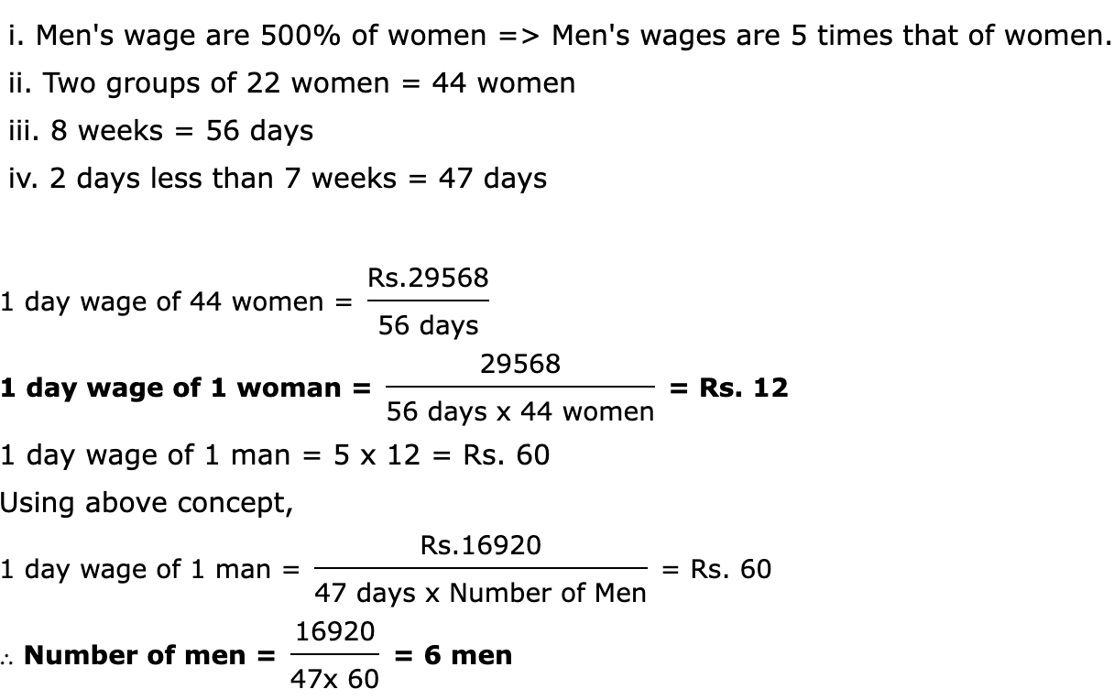
Explanation:
Explanation: 13
Any of (a+b) or a/b could be greater and thus we cannot determine this.

Slide 30
Question: 14
Two friends Raman and Vaman work together on an assignment and take 10 days to finish it and were paid Rs 1155/- for it. If Raman was to work alone, he would take 15 days to finish the assignment. Find their share of each of them in the earnings.
a. Raman = Rs. 770; Vaman = Rs. 385
b. Raman = Rs. 605; Vaman = Rs. 550
c. Raman = Rs. 550; Vaman = Rs. 605
d. Raman = Rs. 385; Vaman = Rs. 770
Notes:
A

Slide 31
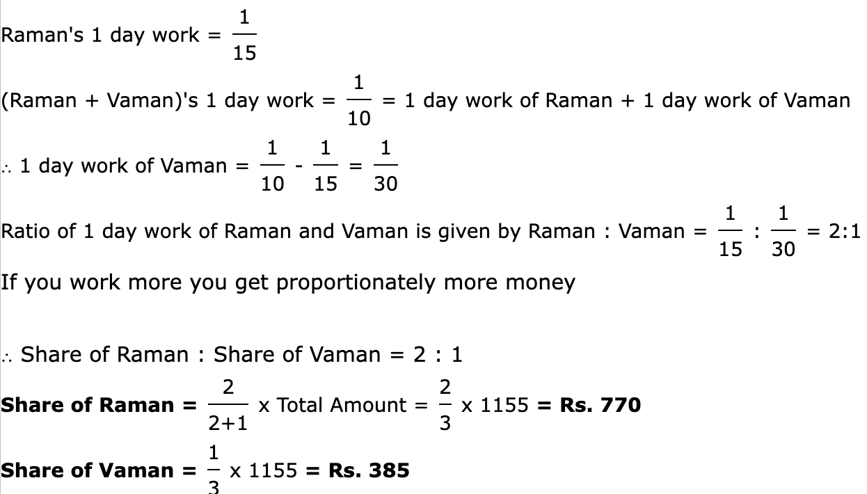
Explanation:
Explanation: 14

Slide 32
Question: 15
P and Q begin with the assignment and finish a particular part of the work. R works alone on the remaining 3/5 of the project. They are paid a total of 640 Rs for the complete work. What should be R's share in the earnings?
a. Rs. 256
b. Rs. 340
c. Rs. 384
d. Rs. 420
Notes:
C

Slide 33
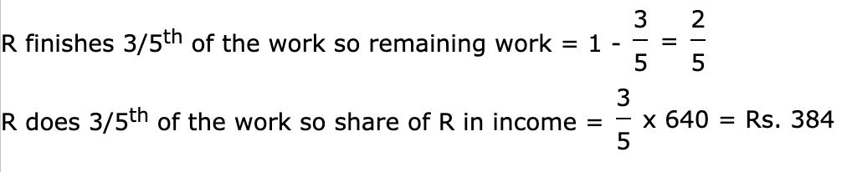
Explanation:
Explanation: 15

Slide 34

https://learn.codemithra.com

Slide 35




THANK YOU
+91 78150 95095
codemithra@ethnus.com
www.codemithra.com

